Slide 1
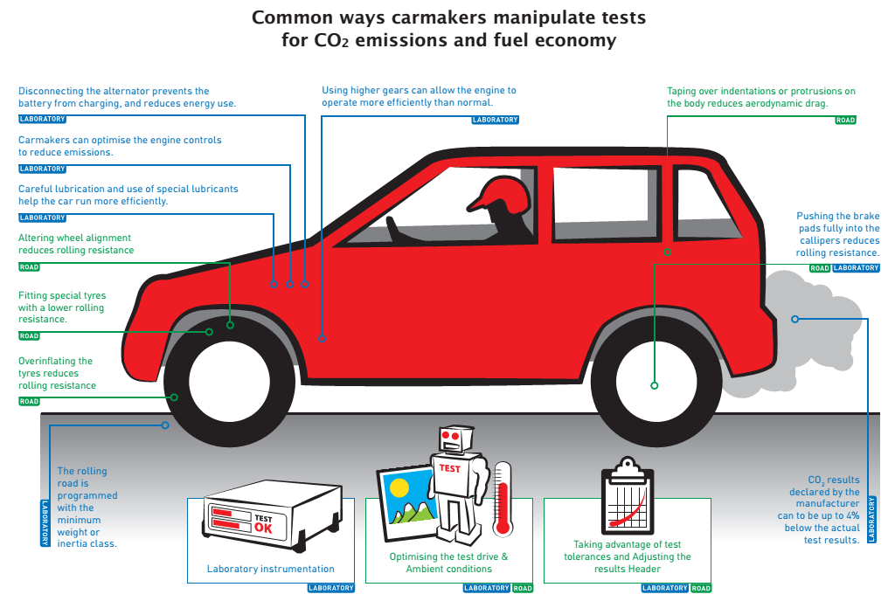
Climate Impact by wrong Fuel Consumption Data and Presentation of own Measurement Results
Dr. Axel Friedrich
Berlin
Dr. Axel Friedrich
Berlin
Notes:
1
1
1
1

Slide 2
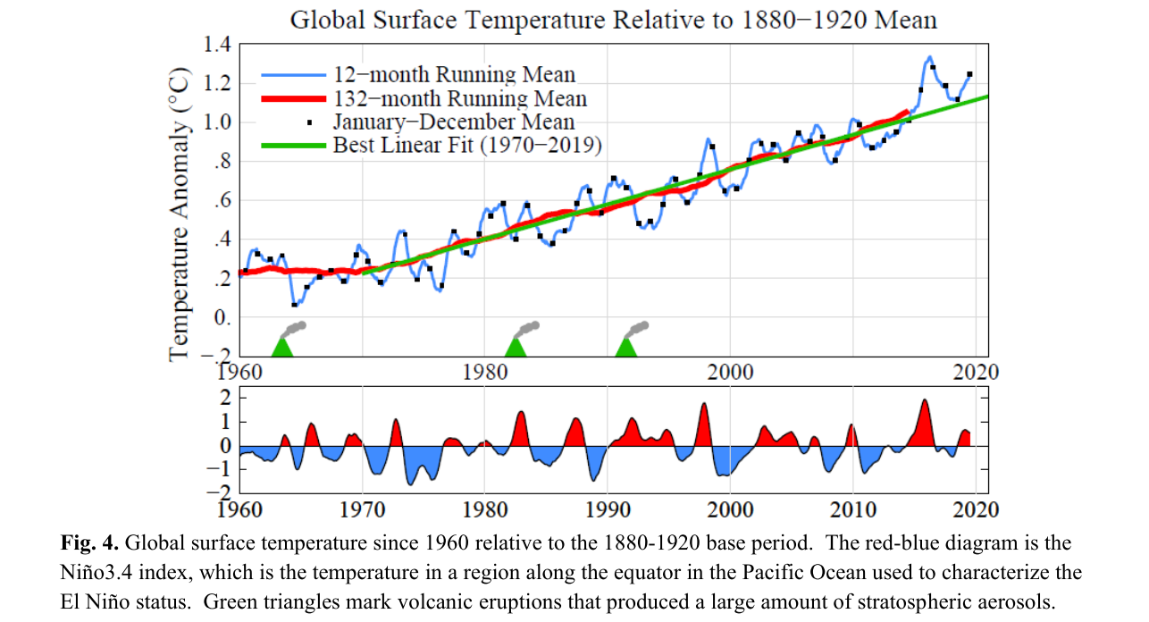

Slide 3
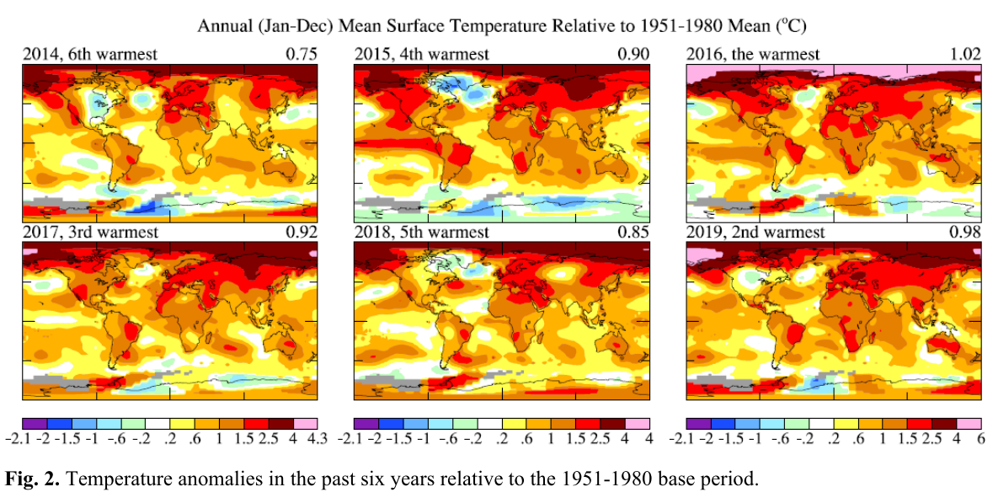

Slide 4
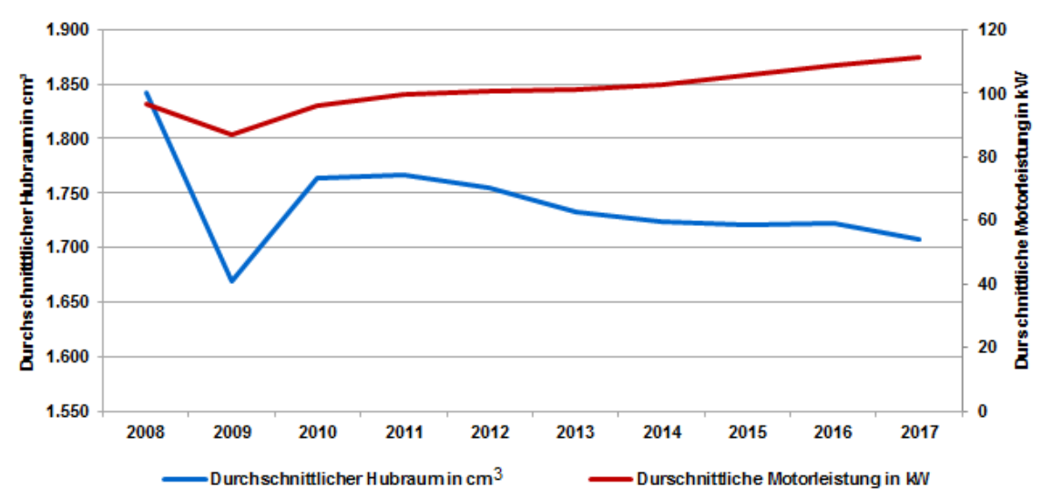


Slide 5
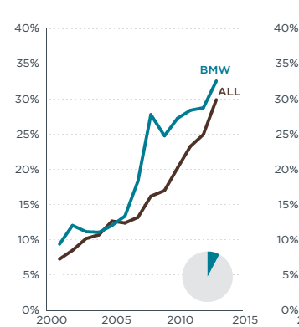
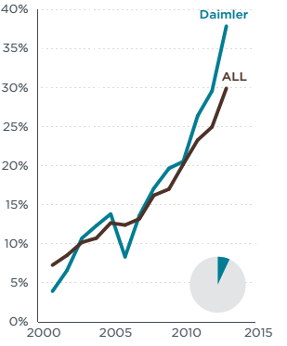
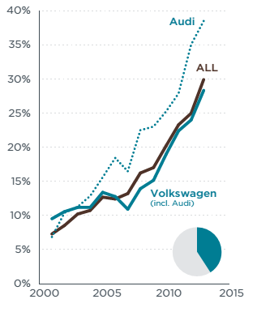

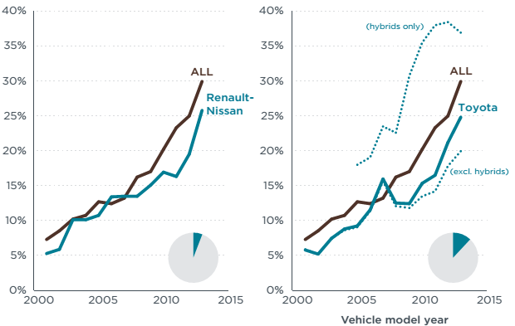
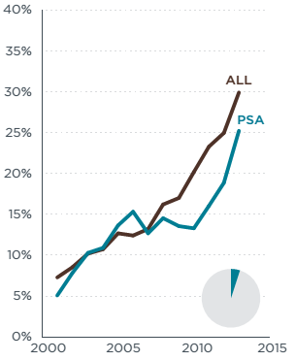

Slide 6
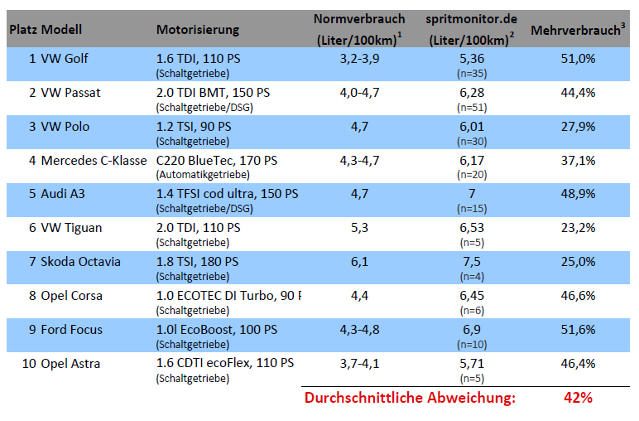
Comparison Manufacturer Data vs. spritmonitor.de, selected Models
Anmerkungen:
¹Herstellerangabe: kombinierter Verbrauchswert nach Vo. (EG) Nr. 715/2007 bzw. Vo. (EG) Nr. 692/2008.
²Durchschnittswert aller Nutzereinträge (Baujahr 2015) für entsprechende Motorisierung, eingesehen am 04.11.2015
³Bei unterschiedlichen Normverbrauchsangaben für die Beispielmotorisierung, bedingt durch verschiedene Modell-/Karosserievarianten, wurde der mittlere Normverbrauchswert zu Vergleichszwecken herangezogen.

Slide 7
Ex. Opel Zafira Tourer vs. Opel Mokka:
Very different Efficiency classes but in real Drive practical identical
 | Opel Zafira Tourer 1.6 CDTi ecoFlex, EZ 2015¹ | Opel Mokka 1.4 Turbo ecoFLEX, EZ 2015²
Offizieller CO2-Ausstoß (NEFZ) (g/km) | 108 | 155
CO2-Ausstoß im realen Fahrbetrieb (g/km) | 155 | 158
Abweichung (%) | 44% | 2%
Masse des Fahrzeugs (kg) | 1816 | 1520
Länge x Breite (m²) | 8,8 | 7,5
CO2-Effizienzklasse | A+ | D
Anmerkungen:
¹Quelle: Angaben des Fahrzeugscheins und https://www.adac.de/infotestrat/autodatenbank/autokatalog/detail.aspx?mid=239397&bezeichnung=opel-zafira-tourer-1-6-cdti-ecoflex-start-stop-active-13-14
(eingesehen am 24.04.2018)
²Quelle: Angaben des Fahrzeugscheins und https://www.adac.de/infotestrat/autodatenbank/autokatalog/detail.aspx?mid=248712&bezeichnung=opel-mokka-1-4-turbo-ecoflex-start-stop-color-edition-4x4-15-16 (eingesehen am 24.04.2018).

Slide 8
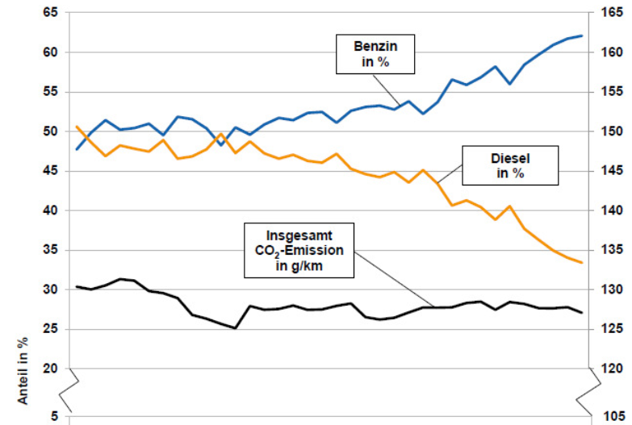

Slide 9
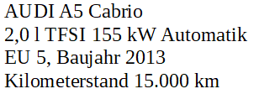

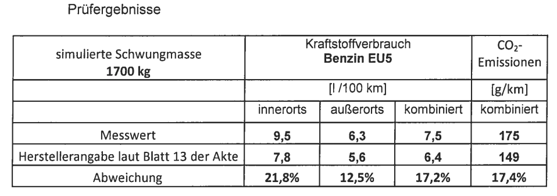
Consumption AUDI A5 2,0 l TFSI EU 5
TÜV NORD

Slide 10
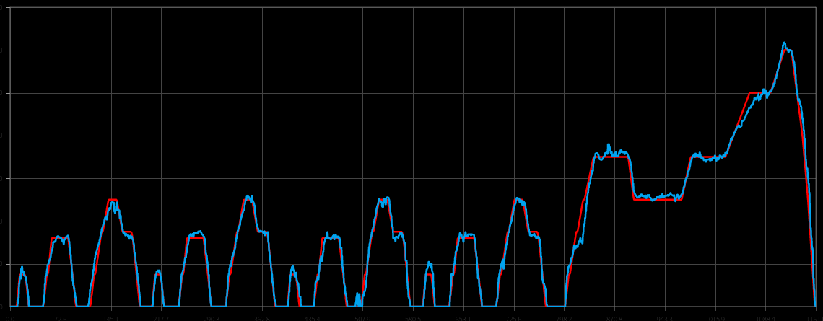
Fuel Consumption Measurement AUDI A5 2,0 l TFSI EU 5
NEDC Road Measurement DUH EKI
The car consumes in the same driving cycle on the road 36 % more than declared from the manufacturer

Slide 11
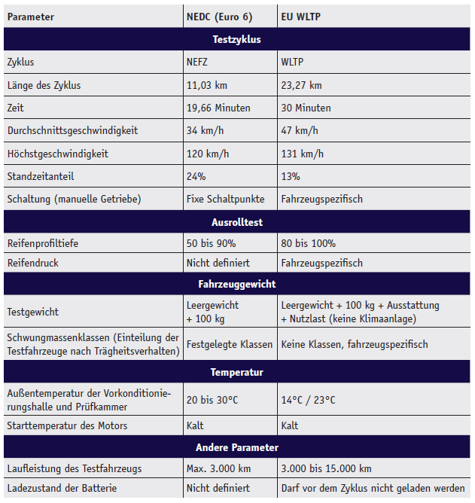
New Test Procedure:
More realistic Consumption Values but the Truth is on the Road
Basic Problem consists: In spite of the improvements by the introduction of the WLTP: Real driving condition aren‘t reflected completely
A cycle recognition or the „optimization“ of the test results in the dynometer test is still possible.
It is likely that WLTP also contains loopholes which can be used by the car manufacture
It is therefor necessary to estimate the CO2 emissions on the road.

Slide 12
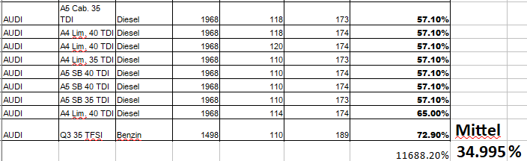
CO₂- Differences between NEDC and WLTP AUDI
Quelle: Bundesamt für Energie / «Kassensturz» 2018, Schweiz

Slide 13
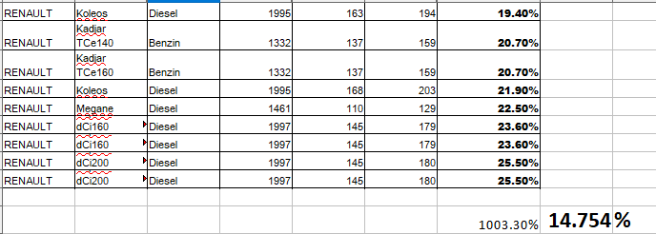
CO₂- Differences between NEDC and WLTP Renault
Source: Bundesamt für Energie / «Kassensturz» 2018,Schweiz

Slide 14
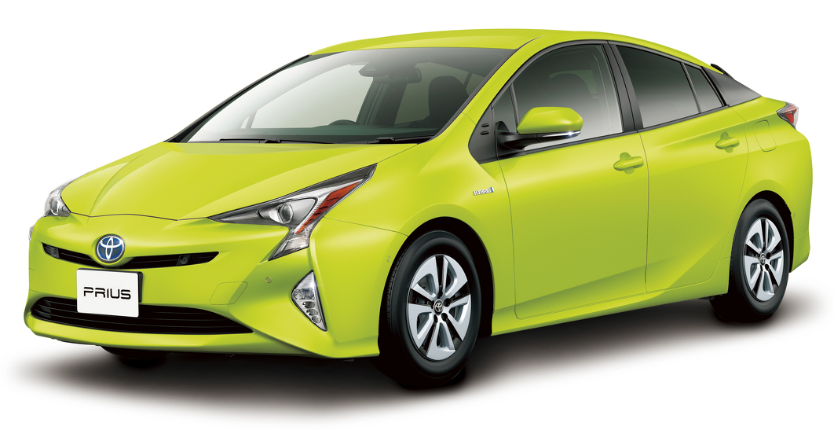
Example Toyota Prius 1.8 CVT: Real consumption in Germany, Japan and USA
 | Germany www.spritmonitor.de | Japan https://e-nenpi.com/ | USA www.fueleconomy.gov
Durch. Kraftstoffverbrauch (l/100km)¹ | 4,74 | 4,36 | 4,03
Anmerkungen:
¹Quelle Deutschland: https://www.spritmonitor.de/de/uebersicht/49-Toyota/439-Prius.html?fueltype=2&gearing=3&exactmodel=4&powerunit=2 (eingesehen am 20.04.2018); Quelle Japan: https://e-nenpi.com/enenpi/cartype/12574 (eingesehen am 20.04.2018); Quelle USA: https://www.fueleconomy.gov/mpg/MPG.do?action=mpgData&vehicleID=37163&browser=true&details=on (eingesehen am 20.04.2018)
Bildnachweis: toyota-media.de

Slide 15
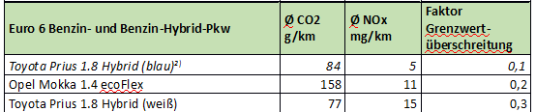

Slide 16


Slide 17
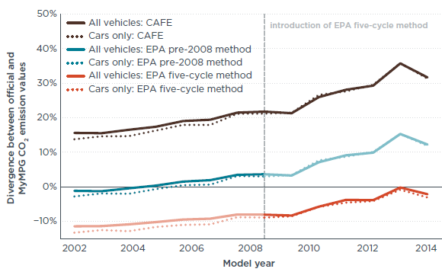
Ex. USA: Environment agency (EPA) corrects manufacture numbers in the interest of the consumer information for the car label
Since 2008 the corrected consumption values are based on total of five test cycles (red linie)
The gap between label values and the average real consumption doesn‘t exist
In contrary the gap between the manufacturer values and real consumption is today about 30% in average
Average gap between manufacturer data or label values and real consumption data for new cars in the USA
Quelle: https://www.theicct.org/publications/laboratory-road-intl

Slide 18
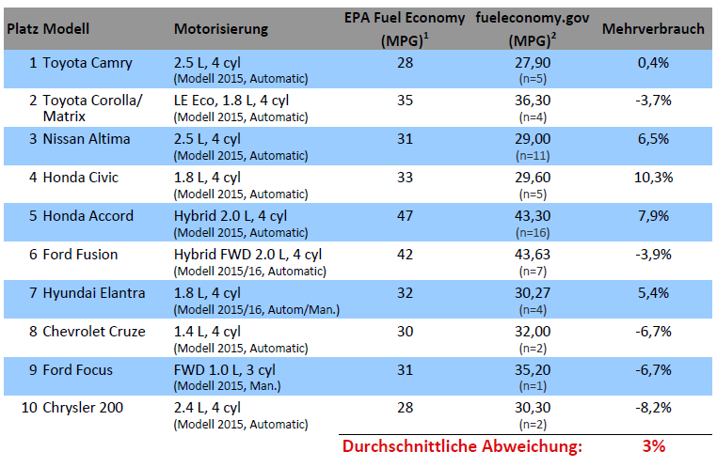
Comparison EPA- Label - Numbers vs. fueleconomy.gov selected Models
Anmerkungen:
¹Verbrauchsangabe laut EPA: "adjusted" and "combined" MPG (Miles-per-Gallon); MPG: höhere Werte bedeuten weniger Verbrauch; 30 MPG entsprechen ca. 7,84 Litern Kraftstoff.
²Durchschnittswert aller Nutzereinträge auf fueleconomy.gov ("Spritmonitor USA") für entsprechende Motorisierung, eingesehen am 04.11.2015.

Slide 19
More CO₂-Reduction is technical feasible and has economical advantage for the Society
Dataof the EU-Commission:
¹Data taken from European Commission (EC) impact assessment
²Data from EC impact assessment, avoided CO₂ costs included, dashed bars use ICCT technology data
³Data from EC impact assessment, assuming battery cells manufactured in the EU
19
Quelle: https://www.theicct.org/blog/staff/no-regrets-eu-co2-std-2025-2030-20180404

Slide 20
A higher CO₂- Reduction has an Advantage for the User of new and used Vehicles
Data EU-Commission:
¹Data taken from European Commission (EC) impact assessment
²Data from EC impact assessment, avoided CO₂ costs included, dashed bars use ICCT technology data
³Data from EC impact assessment, assuming battery cells manufactured in the EU
20
Quelle: https://www.theicct.org/blog/staff/no-regrets-eu-co2-std-2025-2030-20180404

Slide 21
Innovative Technologies lead less Oil- Imports and more Investments / Jobs in Europa
Data der EU-Kommission:
¹Data taken from European Commission (EC) impact assessment
²Data from EC impact assessment, avoided CO₂ costs included, dashed bars use ICCT technology data
³Data from EC impact assessment, assuming battery cells manufactured in the EU
21
Quelle: https://www.theicct.org/blog/staff/no-regrets-eu-co2-std-2025-2030-20180404

Slide 22
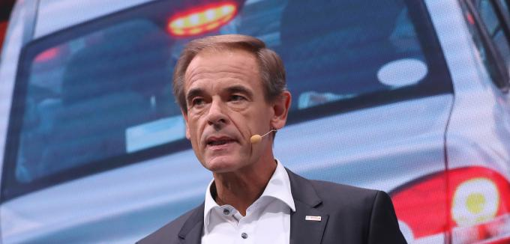
Bosch Boss blames Auto Industry
The boss of the automotive supplier Bosch demands from the German car manufacturers more use for the climate protection.
Bosch boss Volkmar Denner has called for a greater commitment of the automotive industry to the environment. "The automotive industry can do more for climate protection than it has to," wrote Denner in a guest contribution for the "Handelsblatt".
The Bosch boss also criticized the federal government for its exit from the 2020 climate targets: "This strange serenity in the face of a global threat seems almost incomprehensible."
http://www.manager-magazin.de/unternehmen/autoindustrie/bosch-fordert-mehr-klimaschutz-von-vw-und-co-a-1232647.html

Slide 23

Consumer can‘t trust Consumption data anymore

Slide 24
CO₂ is a Pollutant
WASHINGTON (April 2, 2007) – After a four-year court battle, the Supreme Court of the United States ruled today 5-4 that carbon dioxide and other heat-trapping emissions are “air pollutants” under the Clean Air Act, and that the US- government already has authority to start curbing them.
Source: https://www.nrdc.org/media/2007/070402

Slide 25
CO2 Emission Limits
The new alarming data on climate change demand that the vehicle CO2 limits be tightened significantly as part of the revision in 2023.
The current CO₂ limit values for passenger cars do not permit compliance with the objectives of the Paris Agreement.
If CO₂ is a pollutant, then emissions per vehicle must be limited.
Today's limitation of emissions to the mean value of vehicles increases CO2 emissions because high-emitting vehicles drive the mean value strongly upwards.

Slide 26
Reqirements for the Certification of Passenger Cars
CO2 is a pollutant and, like other pollutants, must be effectively limited. The mean value of the emissions is mainly determined by highly emitting vehicles.
As part of the EU CO2 review Process in 2021:
No approval of vehicles with more than 120 g/km from 2025 real on the road.
Plug-ins in vehicles must prove the use of the battery for the recognition of CO₂ emissions.
Introduction of an efficiency standard for e-cars
Proposal: limit 18 kW/h per 100 km.

Slide 27
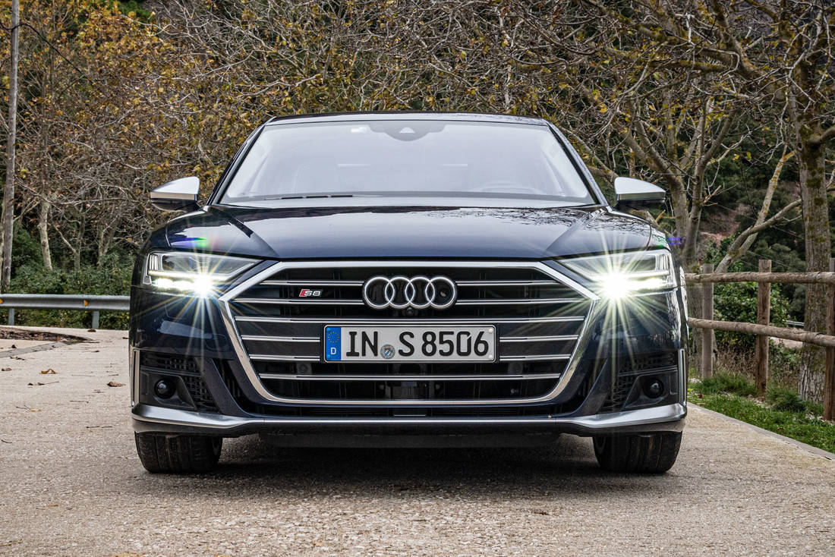
Fortschritt durch Technik
For a long time, the current generation of the Audi A8 was rather neglected. It was overshadowed by the large Q models and constant refreshments in the mid-range segment of the Ingolstadt-based car. The changeover to the WLTP test procedure did not make it easy for the A8 to turn away from diesel even less. But like the phoenix from the ashes, the luxury saloon is now entering the world stage again and is finally allowed to have an eight-cylinder engine. The nine Audi S8 - so to speak the flagship of the flagship. (Fuel consumption combined in l/100 km: 11.3 - 11.4;
CO2 emissions combined g/km: 258 - 260²).
CO2-Emission combined g/km: 258 – 260²).
https://www.autoscout24.de/informieren/testberichte/audi/s8/erster-test-audi-s8-flottes-flaggschiff/

Slide 28
Technical Maximum Speed
Introduction of a technical speed limit in all vehicles, including passenger cars and light commercial vehicles at EU level. For passenger cars 120 km/h max.

Slide 29
Effort Sharing Regulation:
High Cost for the State Budget at Non Compliance of the Targets
● Mandatory national annual GHG budgets for non-ETS sectors
(mainly traffic, building sector, agriculture, waste)
- Coverage for not compliance through trade with other EU member states
- Expectation: from 2021 changed market situation; Market price is at least equal
CO2 avoidance costs in non-ETS sectors (eg EUR 33.5 - 100 / t CO2)
● Annual cost savings for every million tonnes of avoided CO2 would be at
Non-compliance with the GHG budget is € 33.5 - € 100 million.
● The scenarios of the projection report 2017 lead to a cumulative missed target (2021 to 2030) between 150 - 300 million t CO2
- Costs of carbon offsetting of EUR 5 - 30 billion
A higher level of ambition can significantly reduce the cost of the state budget,if the annual national GHG budgets of non-ETS sectors are not met.

Slide 30
Conclusions
1. The CO2 limits for passenger cars in the EU are well below the necessary CO2 reductions.
2. Technically, much more is possible with a positive effect for motorists and society.
3. The E-car regulation allows the increase in CO2 emissions of conventional vehicles.
4. The still used reference vehicle mass is an incentive to sell heavy vehicles.
5.The conversion from NEDC to WLTP can be abused by manufacturers.
It is obvious that, according to the current state of knowledge, the climate goals of the Paris Agreement can not be achieved with today's limits.

Slide 31
axel.friedrich.berlin@gmail.com
Notes:
31
31
31

Slide 32
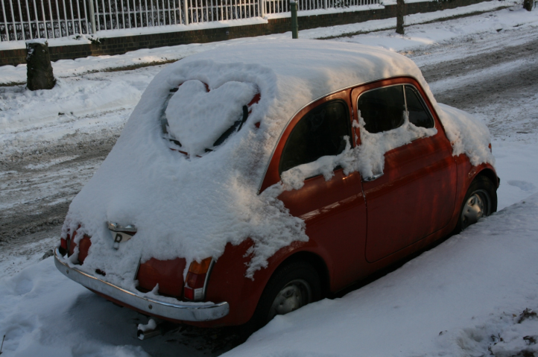
Small is beautiful
Notes:
32
32

